Slide 1
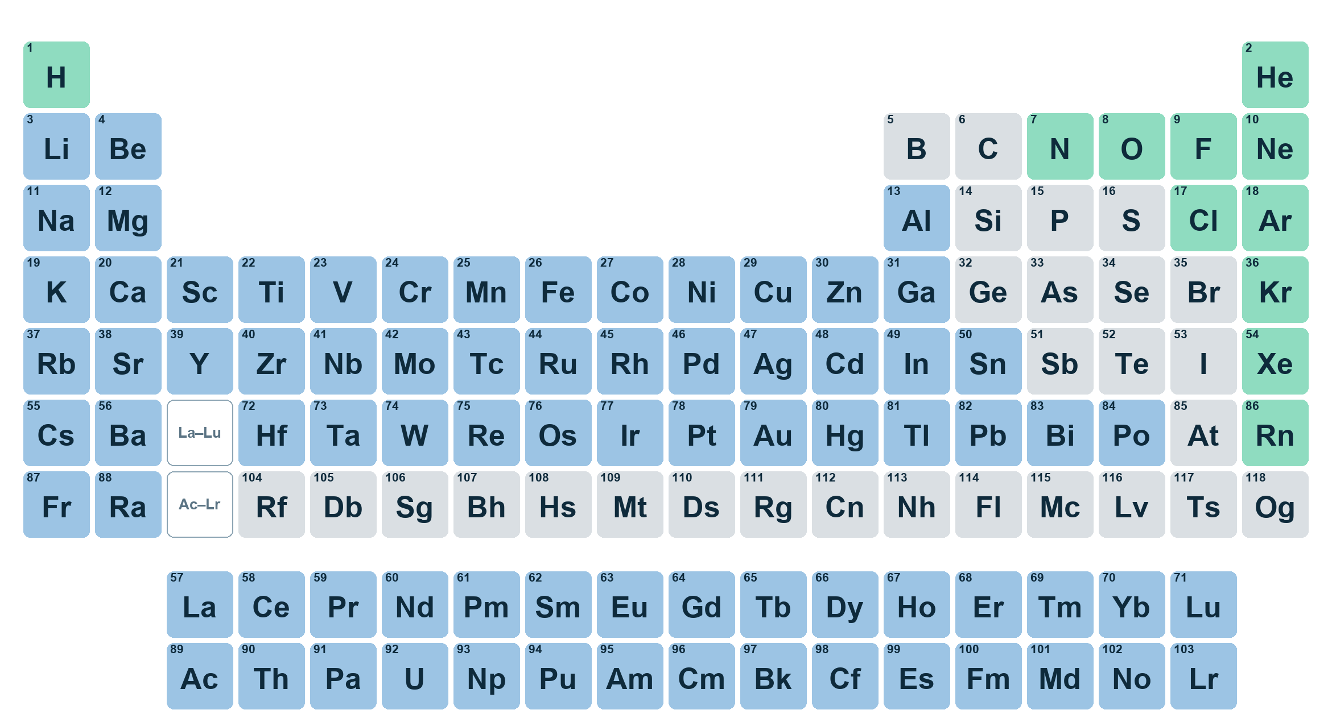
ELEMENTS
Friday 9 October 2026
The
periodic
table
Elements. Symbols. Facts.
Notes:
TITLE. 1 minute. No English needed.
READ THE TITLE slowly, pointing at each line: "The... periodic... table." The class reads it with you, then again without you. Then point at the big coloured picture and say "This is the periodic table." Do not explain it yet: that is slide 5.
THIS IS A ONE-OFF LESSON, AND IT IS FRIDAY P7, the last lesson of the week (CLIL.md): the most active thing goes here and there is no assessment. Today is mostly saying, standing up and pointing, and the worksheet is short on purpose. It follows the Atoms unit: say "everything is made of atoms" (gesture: fingers circling) as they come in, so the idea is warm. Today's new idea is on top of it: an ELEMENT is ONE KIND of atom.
THE FOUR NEW WORDS are element, symbol, metal and gas. Words on photographs (balloon, magnet, wire, bars, tank) are shown with their picture and are not drilled.
CHANGE THE DATE before you teach, if the lesson falls on a different day.

Slide 2



TODAY · 2 MIN
Today
1
2
3
Say the new words.
Find the elements on the table.
Say: “Gold is a metal.”
Notes:
TODAY. 2 minutes. Three clicks.
Read each goal, the class repeats the key words only: "say" (hand from your mouth), "find" (point and look), "say the sentence" (the writing hand, then the mouth). Three pictures, three short lines, move on.
Point at goal 3 and say: "This sentence. All lesson. You will say it many times." They should not be surprised by it when it comes (slide 6).
DO NOT READ LONG OBJECTIVES OUT.

Slide 3
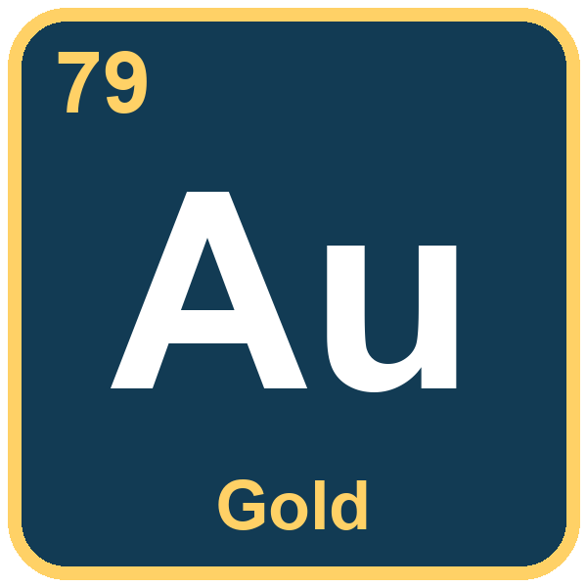
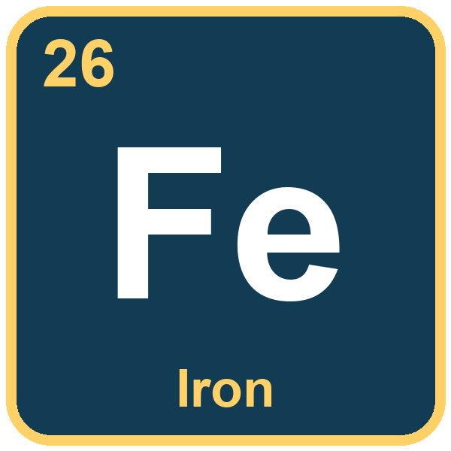
NEW WORDS · 4 MIN
element · symbol
Say the words
element
symbol
EL-e-ment
SIM-bol
One kind of atom. Gold is an element.
A short name. The symbol for iron is Fe.
Notes:
NEW WORDS: ELEMENT, SYMBOL. 4 minutes. Two clicks, one card each. The picture is on screen and the word is hidden. Point at the picture and WAIT. Let them try. Only then click.
FULL DRILL ON BOTH, thirty seconds each: you say it, whole class, half the class, three individuals, then back to the picture with no prompt.
ELEMENT: three beats, stress on the FIRST: EL-e-ment. Thai speakers often put the stress last ("el-uh-MENT") and drop the final t. Clap it: CLAP-clap-clap. GESTURE (new, agreed today): both hands make a small box around ONE thing, as if holding a single object. THE MEANING TIES BACK TO ATOMS: point at the gold tile and say "gold... gold atoms... one kind of atom... an element". Use the atoms gesture (fingers circling) first. Do NOT say "substance" or "chemical" or "pure": "one kind of atom" is enough and it is true.
SYMBOL: two beats, stress on the first: SIM-bol. Say the L at the end. GESTURE (new): write a letter in the air with one finger. THE SYMBOLS ARE READ AS LETTER NAMES: Fe is "eff - ee", Au is "ay - you". Say them that way every time: they will want to say "fee". Point at the tile for iron: "The symbol for iron is Fe. Eff, ee." The real table has the same boxes, with the atomic number in the corner (26 for iron): you do not need to teach the number; point at it and say "a number" if asked.
CHECK with yes/no and either/or only: "Is Fe a symbol?" Yes. "Element or symbol?" (pointing at the word "Iron", then at "Fe"). No open questions yet.
WORDS THEY ALREADY HAVE, use freely: atom (fingers circling), tiny (pinch), part (chop), made of (hands building).

Slide 4
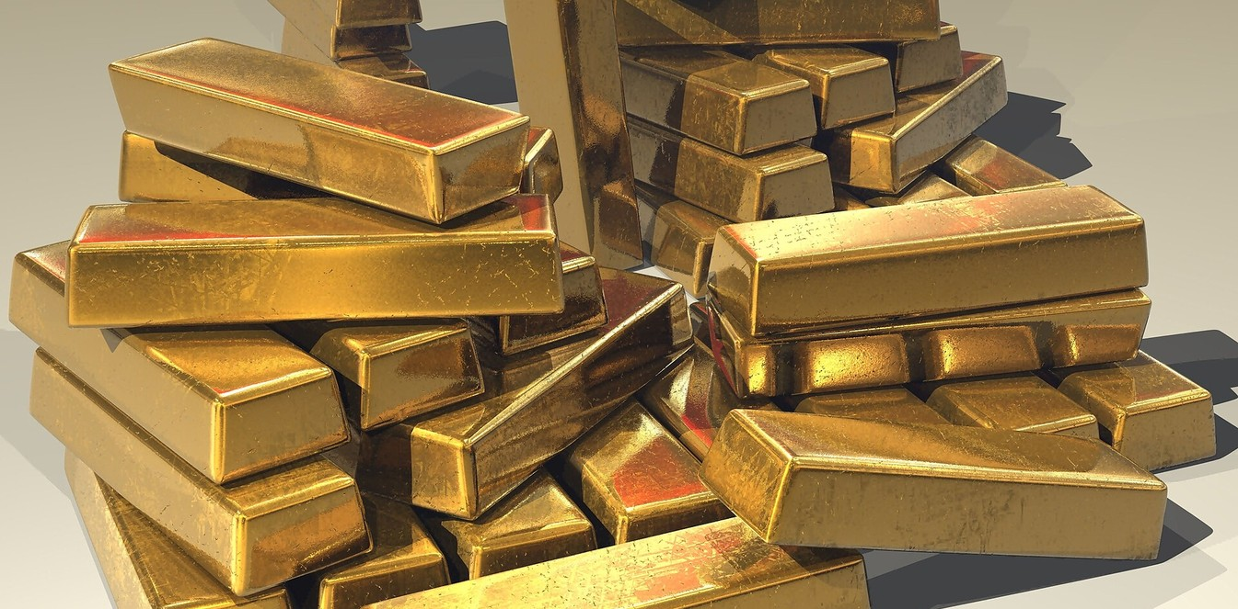

NEW WORDS · 4 MIN
metal · gas
Say the words
metal
gas
MET-al
GAS
Hard and shiny. Gold is a metal.
You cannot hold it. Air is a gas.
Notes:
NEW WORDS: METAL, GAS. 4 minutes. Two clicks. Same order: picture, wait, click. Same thirty-second drill on each.
METAL: two beats, stress on the first: MET-al. Thai speakers often drop the final L ("met-ow"): have them put the tongue behind the top teeth for the L. GESTURE (new): knock on the desk twice with a fist: "knock-knock, metal". Pass a real metal thing around if you have one (a key, a spoon): hard, cold, shiny.
GAS: one beat, and the S at the end must be heard: GASSS. GESTURE (new): wiggle the fingers upwards and let the hands float up. The balloon picture helps: the balloon is full of gas and it floats. Say "air is a gas" and wave a hand through the air: THIS RETURNS TO ATOMS 1 ("air is matter, too"). Do not say "solid" or "liquid": they do not have those words and they do not need them today.
THE PICTURES: gold bars (metal, shiny, hard); two yellow foil balloons in the sky (gas, floating). The balloons are filled with helium, which is the first element on the next slides, so leave the word "helium" for later. PHOTO CREDITS (CC BY-SA 3.0 asks for them; CLAUDE.md puts credits in the notes, not on slides): gold bars, Stevebidmead, CC0 (no credit needed); helium balloons, "Balloons, Belfast, May 2010", Ardfern, CC BY-SA 3.0.
CHECK with either/or, pointing at the pictures: "Metal or gas?" Then yes/no: "Is gold a metal?" "Is a balloon a metal?"

Slide 5
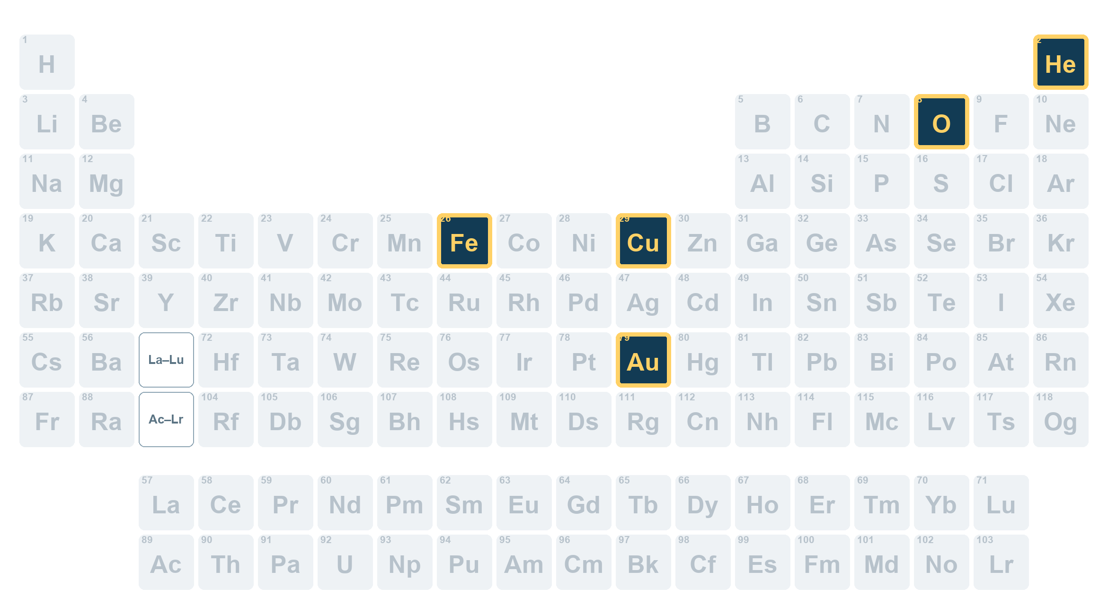
LOOK · 5 MIN
element · symbol · metal · gas
The periodic table
118 elements
One box = one element.
Notes:
LOOK: THE PERIODIC TABLE. 5 minutes. Three clicks: the 118 count, "one box = one element", then the five elements light up. THE TABLE IS ON SCREEN FROM THE START.
POINT AT THE TABLE AND WAIT. They have never seen one like this on the board. Ask, pointing: "Colours?" (blue, green, grey). Then name them with the gestures from the last slide: blue = METAL (knock-knock), green = GAS (floating hands), grey = "other" (shrug: it is the one word on the key you do not teach; say "other" and move on).
CLICK 1: "118 elements." Say the number, write 118 on the board. THE IDEA: everything is made of atoms (fingers circling), and there are 118 different atoms. Each box is one of them, and each one is an ELEMENT. Gold is one box, helium is one box. THE ELEMENTS ARE IN ORDER: the number in the corner of each box counts up, 1, 2, 3 ... 118, left to right, row by row (hydrogen is 1, helium is 2, oxygen is 8, iron is 26, copper is 29, gold is 79). You do not need to teach the numbers.
CLICK 2: "One box. One element." Point at three boxes and say "an element, an element, an element".
CLICK 3: the five elements for today light up in dark boxes with a yellow edge: He, O, Fe, Cu, Au. Point at each and say the symbol as LETTER NAMES: He is "aitch, ee" (never "he"), O is "oh", Fe is "eff, ee", Cu is "see, you", Au is "ay, you". THEY WILL NOT BE ABLE TO READ ALL 118 NAMES AND SHOULD NOT TRY: the only goal is "I can find five boxes". Finding them on the worksheet picture comes later.
WHAT THE COLOURS MEAN, for you: blue = metals, green = the 11 elements that are gases at room temperature (H, He, N, O, F, Ne, Cl, Ar, Kr, Xe, Rn), grey = other (solids that are not metals, such as carbon and sulfur, a few in between, bromine, and the elements 104 to 118, which are made in laboratories and are not coloured as metals because little is known about them). If a student asks about the grey ones, say "other". The two long rows under the table are part of the table: they belong in the gaps marked La to Lu and Ac to Lr.
CHECK, yes/no and either/or: "Is this a table?" "Is He an element?" "Is this box blue or green?"

Slide 6

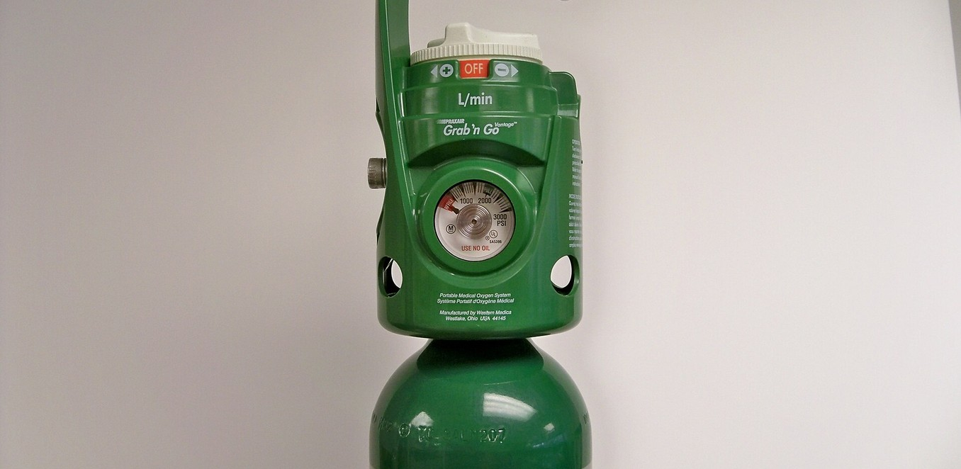
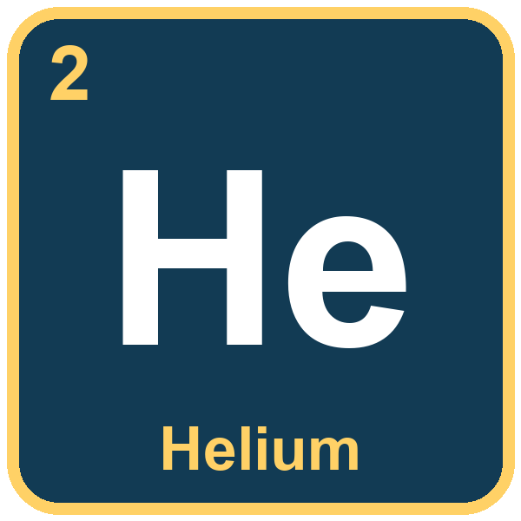
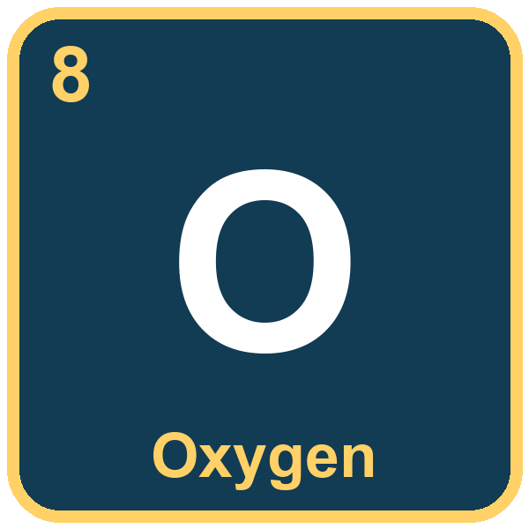
I DO · 4 MIN
gas · symbol
Two gases
Helium is a gas.
Its symbol is He.
Helium is in a balloon.
Oxygen is a gas.
Its symbol is O.
We breathe oxygen.
Helium
Oxygen
Notes:
I DO: TWO GASES. 4 minutes. Two clicks: helium, then oxygen. Each click brings the photograph, the tile and the three sentences. THE FRAME IS NOT ON THIS SLIDE (it comes with the sorting in the You Say): say the sentences, they repeat, with the gestures.
HELIUM: "HEE-lee-um", three beats, stress on the first. It is the gas in the balloons in the photo, and it makes them float. Say "Helium is a gas" (floating hands). "Its symbol is He": write He in the air. Then "Helium is in a balloon." Class repeats each sentence. THE SYMBOL He is read as two letter names, "aitch-ee", never "he".
OXYGEN: "OK-si-jen", three beats, stress on the first. Thai speakers often say "ok-SEE-jen". The photograph is an oxygen tank, the kind used in hospitals; say "a tank". "Oxygen is a gas. Its symbol is O" (the letter, "oh"). "We breathe oxygen": take a big breath in, pointing at your chest, and have them copy. THIS LINKS TO THEIR LIVING-THINGS UNIT: living things need air, and oxygen is the part of the air that we breathe. About one fifth of the air is oxygen: you do not need to say the number. Do not say "pure oxygen" or "oxygen is in our blood": too much.
CHECK, either/or, pointing at the photograph: "Helium or oxygen?" Then yes/no: "Is oxygen a gas?" "Is the symbol for helium O?"
PHOTO CREDITS (CLAUDE.md puts credits in the notes): helium balloons, "Balloons, Belfast, May 2010", Ardfern, CC BY-SA 3.0; oxygen cylinder, US Food and Drug Administration, public domain.
THE ATOM LINK, say once: "Helium is a gas. A helium atom is tiny" (pinch). "An oxygen atom is tiny." Every element is one kind of atom.

Slide 7
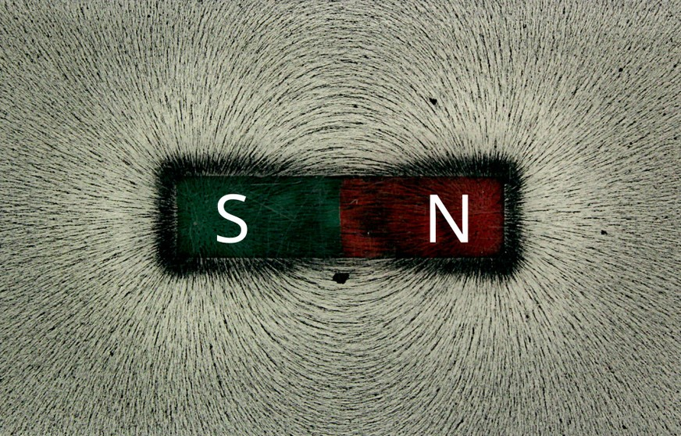
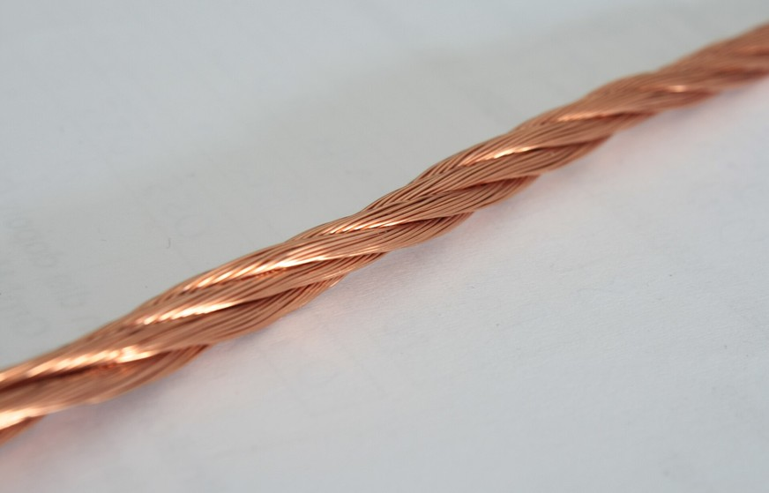
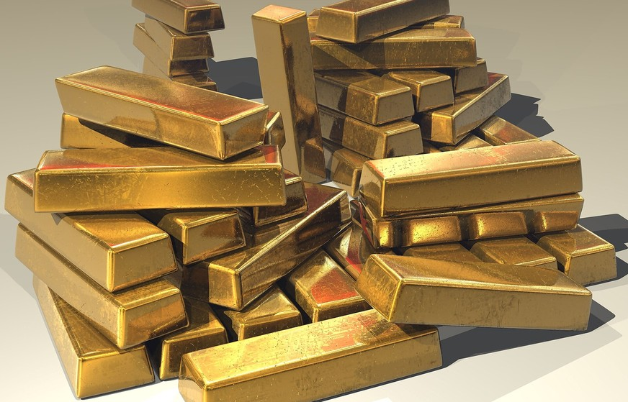
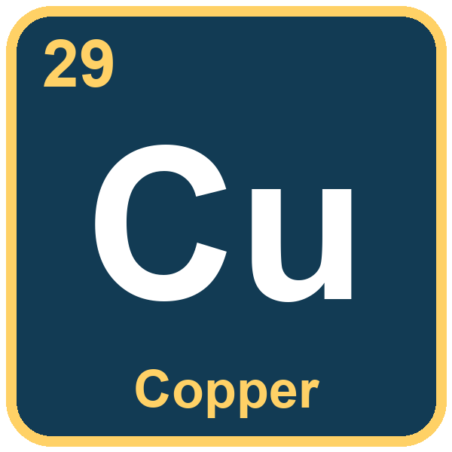
I DO · 5 MIN
metal · symbol
Three metals
Iron is a metal.
Its symbol is Fe.
A magnet pulls iron.
Copper is a metal.
Its symbol is Cu.
Copper is in a wire.
Gold is a metal.
Its symbol is Au.
Gold is in bars.
Notes:
I DO: THREE METALS. 5 minutes. Three clicks: iron, copper, gold. Each brings the photograph, the tile and the three sentences. Same routine as the gases: you say it, they repeat, with the gestures (knock-knock for metal, write the letters in the air).
IRON: "EYE-un", two beats (British: the R is silent in speech). Thai speakers often say "eye-ron". The picture is a bar magnet with iron filings round it: the tiny bits of iron line up because the magnet pulls them. "A magnet pulls iron": pull your hands together. THE SYMBOL Fe is "eff-ee", and it does NOT look like the name. Tell them: "Fe comes from the old Latin name for iron, ferrum." Then move on. (Hold up a magnet and a paper clip if you have them: the clip is steel, which is mostly iron, and it jumps.)
COPPER: "KOP-er", two beats. The picture is a twisted copper wire: pink-brown and shiny. "Copper is in a wire": make a long line with a finger. Symbol Cu, "see-you": from the Latin name cuprum. If a student asks why: electricity goes through copper easily, which is why wires are made of copper. Do not go further.
GOLD: "GOHLD", one beat, and the D at the end must be heard. The picture is a pile of gold bars. "Gold is in bars." Symbol Au, "ay-you", from the Latin name aurum. A fun fact for the keen ones: Au does not look like "gold" and Fe does not look like "iron" because the symbols come from older Latin names. Say it once.
A CHECK AFTER EACH: either/or on the symbol ("Fe or Cu?") and yes/no on the metal ("Is iron a metal?").
PHOTO CREDITS (CLAUDE.md puts credits in the notes): iron filings and magnet, "Bar-magnet-iron-filings max", MikeRun and Vera Wurmsdobler, CC BY-SA 4.0; copper wire, "Enamelled litz copper wire", Alisdojo, CC0; gold bars, Stevebidmead, CC0.

Slide 8


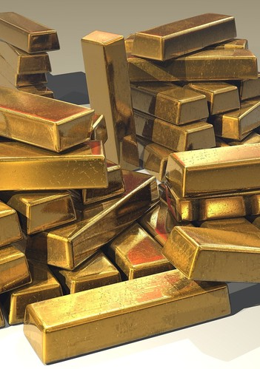
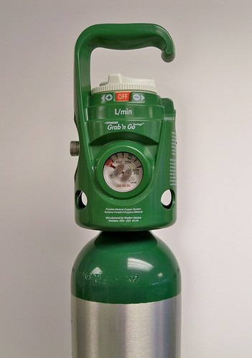
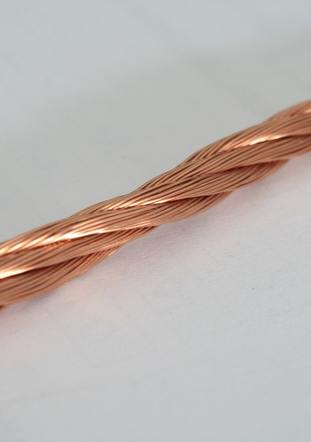
YOU SAY · 4 MIN
metal · gas · symbol
Yes or no?
Is helium a gas?
Is iron a gas?
Is gold a metal?
YES
NO
YES
Is oxygen a metal?
Is the symbol for copper Cu?
Is the symbol for iron Au?
NO
YES
NO
___ is a ___. Its symbol is ___.
Notes:
YOU SAY, PART A: YES OR NO. 4 minutes. Six clicks, one answer each. Yes/no questions come first because they need the least English. THE FRAME AT THE BOTTOM IS ON SCREEN AND STAYS ON EVERY SLIDE FROM HERE: "___ is a ___. Its symbol is ___."
THE ROUTINE FOR EACH QUESTION: point at the picture and ask. They answer "Yes!" or "No!" with the gesture (a nod; a shake of the head). The stronger ones add the sentence: "Yes. Helium is a gas." "No. Iron is a metal." Take the sentence from one student, then the whole class repeats it. Click: the answer appears.
THE SIX ARE MIXED ON PURPOSE: two about gas or metal that are yes, two that are no, then two about the SYMBOL (Cu yes, Au for iron no). THE NO ANSWERS ARE THE POINT: "Is iron a gas?" No: iron is a metal. Do not let a "no" end without the right sentence. "Is the symbol for iron Au?" No: it is Fe (write in the air). Common mistakes: "Cu" read as "see-you" is right; some will say "kyoo".
IF THE ROOM IS SILENT, go back to slide 6 and 7 for that element. IF THE ROOM IS FLUENT, skip to the next slide: they are ready for the pairs.
PHOTO CREDITS are on slides 4, 6 and 7.

Slide 9

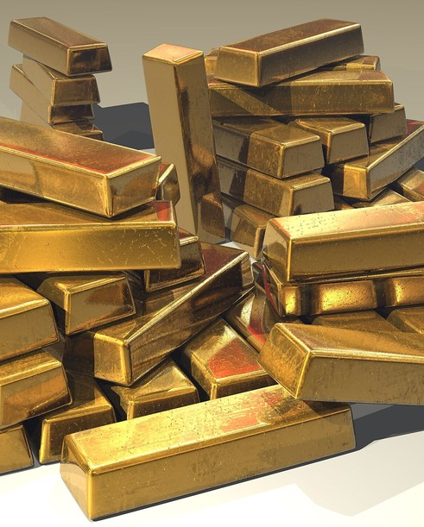
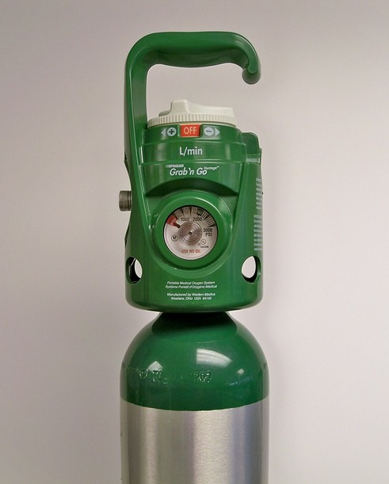
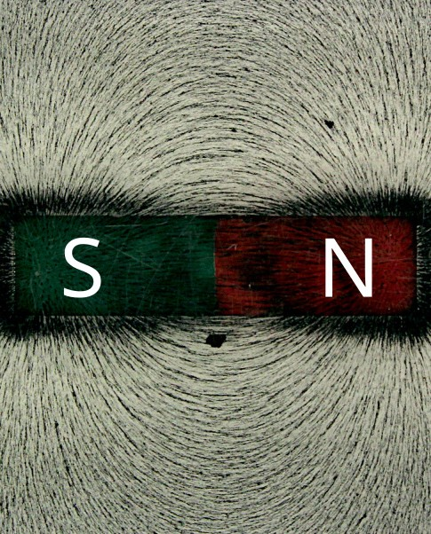
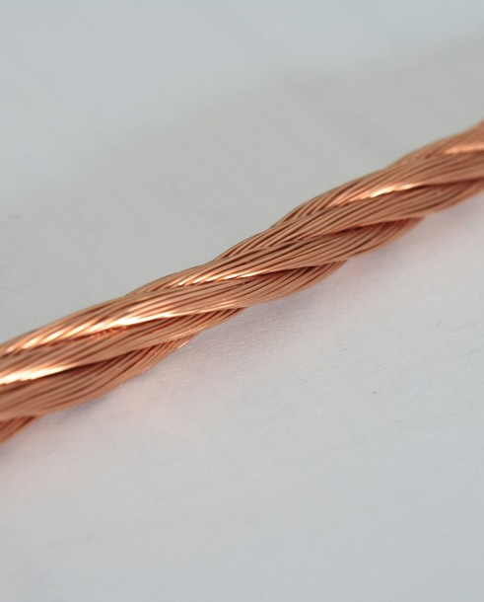
YOU SAY · 6 MIN
metal · gas
Metal or gas?
metal: stand tall and knock gas: float your hands up
helium
gold
oxygen
iron
copper
gas
metal
gas
metal
metal
___ is a ___. Its symbol is ___.
Notes:
YOU SAY, PART B: EITHER/OR, STANDING, IN PAIRS. 6 minutes, the biggest block and the active one (Friday P7). Five clicks, one answer each. THE FRAME STAYS AT THE BOTTOM.
THE GAME, everyone standing, then pairs. Point at a picture. If the element is a METAL, they stand tall and knock twice on the desk ("knock-knock"). If it is a GAS, they float their hands up and wiggle their fingers. They ALL do it at the same time and the sentence follows: "Gold is a metal." "Helium is a gas." Click: the answer appears in blue (metal) or green (gas), matching the colours on the table.
THE ORDER IS MIXED ON PURPOSE: gas, metal, gas, metal, metal: so nobody can guess a pattern. Wait a beat before they move: they should decide first. THEN PAIRS (the last three minutes): A points at a picture, B says the whole sentence with the gesture, then they swap. This is where the speaking minutes are (CLIL.md). Walk round and listen for "Gold is a metal" with the S on "gas" and the D on "gold".
THE EITHER/OR QUESTION is always the same: "Metal or gas?" They answer with the whole frame, then add the symbol if they can: "Its symbol is Au." Take the symbol from one student, then the whole class repeats it.
A TRAP: carbon, silver and other metals will come to mind from the table or from home. For today only the five count. If a student asks, "good question: we only meet five today".

Slide 10
YOU SAY · 4 MIN
element · symbol
Find it on the table
1
Find He. Say the sentence.
2
Find the symbol for gold.
3
Tell your partner a fact.
A fact: “Oxygen is a gas.” “We breathe oxygen.” “A magnet pulls iron.”
___ is a ___. Its symbol is ___.
Notes:
YOU SAY, PART C: OPEN. 4 minutes. Three clicks, one prompt each. The five elements are lit on the table. THE FRAME STAYS AT THE BOTTOM. Yes/no and either/or came first; now the question is open, but the frame carries them.
PROMPT 1: "Find He. Say the sentence." They come to the board or point on the worksheet picture (slide 11): where is He? Top right corner. "Helium is a gas. Its symbol is He." PROMPT 2: "Find the symbol for gold." Au, in the lower middle: "Gold is a metal. Its symbol is Au." Ask "Au: what colour is the box?" (blue: a metal). PROMPT 3: "Tell your partner a fact." They use the facts line at the bottom of the slide as help: three facts to choose from. The strongest add a fourth of their own ("Copper is in a wire"). Listen, do not correct pronunciation mid-sentence: repeat it back correctly.
THE PICTURE HELPS THE FINDING: He is alone in the top right; O is in the second row near the right; Fe, Cu are in the fourth row; Au is in the sixth row. Say it only if they cannot find them.
THIS IS THE LAST SPEAKING BEFORE THE WORKSHEET. If the room is quiet, run the either/or again for two minutes.

Slide 11

YOU DO · 8 MIN
Your worksheet
A
B
C
Look and write.
Sort.
Write.
Write the element and its symbol for each picture.
Write each element in the right box: metal or gas.
Write the sentence: Gold is a metal. Its symbol is Au.
Word bank element · symbol · metal · gas · helium · oxygen · iron · copper · gold
Point first. Then say the whole sentence.
Notes:
YOU DO. 8 minutes, short on purpose: it is Friday P7. Four clicks: A, B, C, then the banner. The word bank stays on screen.
THE WORKSHEET (picture-led; no matching lines; a word bank and a writing line). A: five small photographs (helium, oxygen, iron, copper, gold): write the name and the symbol under each. They copy from the word bank and from the table picture on the sheet. B: sort the five names into two boxes, metal and gas. C: copy the sentence for gold, then write one of their own about helium or oxygen with the frame. THE PERIODIC TABLE IS PRINTED ON THE SHEET, with the five elements lit, so they can find the symbols.
BEFORE THEY WRITE, EVERY TIME: "Point first. Then say the whole sentence." They point at the picture, say the sentence aloud, THEN write it. Walk round and listen first, read second.
COMMON SLIPS to look for: "He" copied as "he"; Au written "AU" or "au" (the symbol is a capital A and a small u: the real table is written that way, say so); Cu as "CU"; "irony" for "iron". If a student finishes early, they write a fourth fact about one element with the frame ("Copper is in a wire.").
AT 2 MINUTES REMAINING, stop them and go to the last slide. The answers are upside down at the end of the worksheet, for you.

Slide 12

TOGETHER · 3 MIN
Say it together
Gold is a metal. Its symbol is Au.
Helium is a gas.
Its symbol is He.
Oxygen is a gas.
Its symbol is O.
Iron is a metal.
Its symbol is Fe.
Copper is a metal.
Its symbol is Cu.
Gold is a metal.
Its symbol is Au.
Notes:
SAY IT TOGETHER. 3 minutes. Six clicks: the big sentence, then five rows, one element each, with a tick. THE PLENARY EVERYONE CAN WIN (CLIL.md): every answer is correct, so everyone succeeds out loud.
THE BIG SENTENCE FIRST, whole class, twice, with the gestures: element (hands make a small box), metal (knock-knock), gas (floating hands). Then each row: point at the tile and let them say the two sentences off the tile alone ("Helium is a gas. Its symbol is He."). The tile gives the symbol and the name; the sentence is theirs.
THEN A QUICK ROUND: you point at a tile, a student says the sentence, the class says "Yes!" with the nod. Everyone says at least one. THE LAST SENTENCE, the one for gold, is the one on the worksheet.
END ON THE BIG PICTURE, if you have a minute: "Everything is made of atoms. There are 118 elements. Today we met five." Finish with "Well done." There is NO "next lesson" line: this lesson is a one-off.

